Slide 1
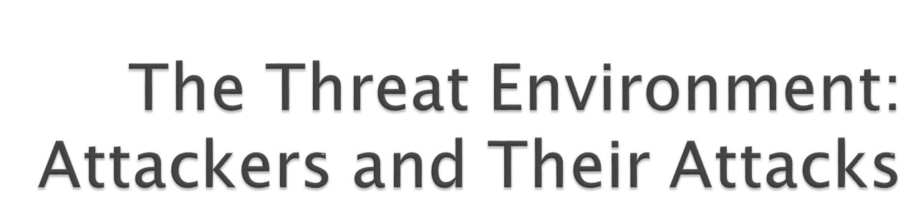
Chapter 1
Raymond R. Panko
Corporate Computer and Network Security, 2nd Edition
Copyright Pearson Prentice-Hall, 2010

Slide 2

This is a book about security defense, not how to attack
  Defense is too complex to focus the book mostly on specific attacks
However, this first chapter looks at the threat environment—attackers and their attacks
Unless you understand the threats you face, you cannot prepare for defense
All subsequent chapters focus on defense
Copyright Pearson Prentice-Hall 2010

Slide 3

The Threat Environment
  The threat environment consists of the types of attackers and attacks that companies face
Copyright Pearson Prentice-Hall 2010

Slide 4
Security Goals
  Confidentiality
    Confidentiality means that people cannot read sensitive information, either while it is on a computer or while it is traveling across a network.
Copyright Pearson Prentice-Hall 2010

Slide 5
Security Goals
  Integrity
    Integrity means that attackers cannot change or destroy information, either while it is on a computer or while it is traveling across a network. Or, at least, if information is changed or destroyed, then the receiver can detect the change or restore destroyed data.
Copyright Pearson Prentice-Hall 2010

Slide 6
Security Goals
  Availability
    Availability means that people who are authorized to use information are not prevented from doing so
Copyright Pearson Prentice-Hall 2010

Slide 7
Compromises
  Successful attacks
  Also called incidents
  Also called breaches (not breeches)
Copyright Pearson Prentice-Hall 2010

Slide 8
Countermeasures
  Tools used to thwart attacks
  Also called safeguards, protections, and controls
  Types of countermeasures
    Preventative
    Detective
    Corrective
Copyright Pearson Prentice-Hall 2010

Slide 9

The TJX Companies, Inc. (TJX)
  A group of more than 2,500 retail stores companies operating in the United States, Canada, England, Ireland, and several other countries
  Does business under such names as TJ Maxx and Marshalls
Copyright Pearson Prentice-Hall 2010

Slide 10
Discovery
  On December 18, 2006, TJX detected “suspicious software” on its computer systems
  Called in security experts who confirmed an intrusion and probable data loss
  Notified law enforcement immediately
  Only notified consumers a month later to get time to fix system and to allow law enforcement to investigate
Copyright Pearson Prentice-Hall 2010

Slide 11
Discovery
  Two waves of attacks, in 2005 and 2006
  Company estimated that 45.7 million records with limited personal information included
  Much more information was stolen on 455,000 of these customers
Copyright Pearson Prentice-Hall 2010

Slide 12
The Break-Ins
  Broke into poorly protected wireless networks in retail stores
  Used this entry to break into central processing system in Massachusetts
  Not detected despite long presence, 80 GB data exfiltration
  Canadian privacy commission: poor encryption, keeping data that should not have been kept
Copyright Pearson Prentice-Hall 2010

Slide 13
The Payment Card Industry-Data Security Standard (PCI-DSS)
  Rules for companies that accept credit card purchases
  If noncompliant, can lose the ability to process credit cards
  12 required control objectives
  TJX knew it was not in compliance (later found to meet only 3 of 12 control objectives)
  Visa gave an extension to TJX in 2005, subject to progress report in June 2006
Copyright Pearson Prentice-Hall 2010

Slide 14
The Fall-Out: Lawsuits and Investigations
  Settled with most banks and banking associations for $40.9 million to cover card reissuing and other costs
  Visa levied $880,000 fine, which may later have been increased or decreased
  Proposed settlement with consumers
  Under investigation by U.S. Federal Trade Commission and 37 state attorneys general
  TJX has prepared for damages of $256 million as of August 2007
Copyright Pearson Prentice-Hall 2010

Slide 15
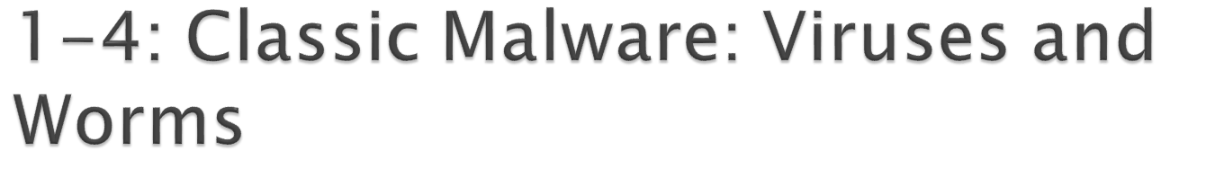
Malware
  A generic name for any “evil software”
Viruses
  Programs that attach themselves to legitimate programs on the victim’s machine
  Spread today primarily by e-mail
  Also by instant messaging, file transfers, etc.
Copyright Pearson Prentice-Hall 2010

Slide 16
Worms
  Full programs that do not attach themselves to other programs
  Like viruses, can spread by e-mail, instant messaging, and file transfers
Copyright Pearson Prentice-Hall 2010

Slide 17
Worms
  In addition, direct-propagation worms can jump from one computer to another without human intervention on the receiving computer
  Computer must have a vulnerability for direct propagation to work
  Direct-propagation worms can spread extremely rapidly because they do not have to wait for users to act
Copyright Pearson Prentice-Hall 2010

Slide 18
Blended Threats
  Malware propagates in several ways—like worms, viruses, compromised webpages containing mobile code, etc.
Payloads
  Pieces of code that do damage
  Implemented by viruses and worms after propagation
  Malicious payloads are designed to do heavy damage
Copyright Pearson Prentice-Hall 2010

Slide 19

Nonmobile Malware
  Must be placed on the user’s computer through one of a growing number of attack techniques
  Placed on computer by hackers
  Placed on computer by virus or worm as part of its payload
  The victim can be enticed to download the program from a website or FTP site
  Mobile code executed on a webpage can download the nonmobile malware
Copyright Pearson Prentice-Hall 2010

Slide 20
Trojan Horses
  A program that replaces an existing system file, taking its name
Trojan Horses
  Remote Access Trojans (RATs)
    Remotely control the victim’s PC
  Downloaders
    Small Trojan horses that download larger Trojan horses after the downloader is installed
Copyright Pearson Prentice-Hall 2010

Slide 21
Trojan Horses
  Spyware
    Programs that gather information about you and make it available to the adversary
    Cookies that store too much sensitive personal information
    Keystroke loggers
    Password-stealing spyware
    Data mining spyware
Copyright Pearson Prentice-Hall 2010

Slide 22
Trojan Horses
  Rootkits
    Take control of the super user account (root, administrator, etc.)
    Can hide themselves from file system detection
    Can hide malware from detection
    Extremely difficult to detect (ordinary antivirus programs find few rootkits)
Copyright Pearson Prentice-Hall 2010

Slide 23
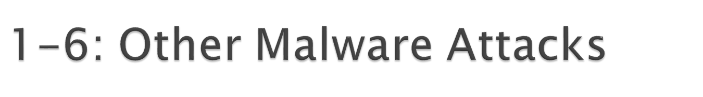
Mobile Code
  Executable code on a webpage
  Code is executed automatically when the webpage is downloaded
  Javascript, Microsoft Active-X controls, etc.
  Can do damage if computer has vulnerability
Copyright Pearson Prentice-Hall 2010

Slide 24
Social Engineering in Malware
  Social engineering is attempting to trick users into doing something that goes against security policies
  Several types of malware use social engineering
    Spam
    Phishing
    Spear phishing (aimed at individuals or specific groups)
    Hoaxes
Copyright Pearson Prentice-Hall 2010

Slide 25
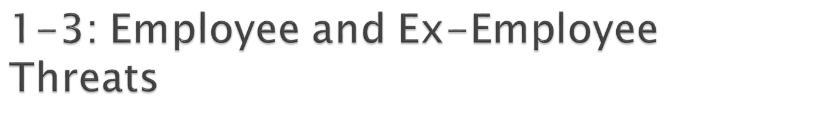
Employees and Ex-Employees Are Dangerous
  Dangerous because
    They have knowledge of internal systems
    They often have the permissions to access systems
    They often know how to avoid detection
    Employees generally are trusted
  IT and especially IT security professionals are the greatest employee threats (Qui custodiet custodes?)
Copyright Pearson Prentice-Hall 2010

Slide 26
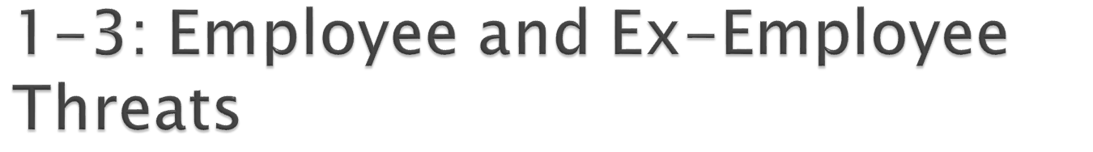
Employee Sabotage
  Destruction of hardware, software, or data
  Plant time bomb or logic bomb on computer
Employee Hacking
  Hacking is intentionally accessing a computer resource without authorization or in excess of authorization
  Authorization is the key
Copyright Pearson Prentice-Hall 2010

Slide 27
Employee Financial Theft
  Misappropriation of assets
  Theft of money
Employee Theft of Intellectual Property (IP)
  Copyrights and patents (formally protected)
  Trade secrets: plans, product formulations, business processes, and other info that a company wishes to keep secret from competitors
Copyright Pearson Prentice-Hall 2010

Slide 28
Employee Extortion
  Perpetrator tries to obtain money or other goods by threatening to take actions that would be against the victim’s interest
  …
Copyright Pearson Prentice-Hall 2010

Slide 29
Internet Abuse
  Downloading pirated software, music, and video, which can lead to copyright violation penalties
  Excessive personal use of the Internet at work
Copyright Pearson Prentice-Hall 2010

Slide 30
Carelessness
  Loss of computers or data media containing sensitive information
  Careless leading to the theft of such information
Other “Internal” Attackers
  Contract workers
  Workers in contracting companies
Copyright Pearson Prentice-Hall 2010

Slide 31
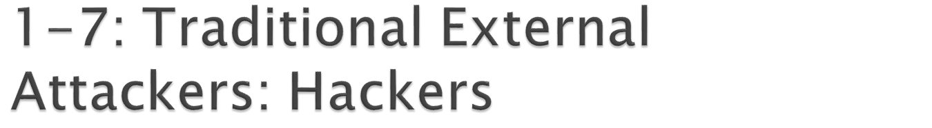
Traditional Hackers
  Motivated by thrill, validation of skills, sense of power
  Motivated to increase reputation among other hackers
  Often do damage as a byproduct
  Often engage in petty crime
Copyright Pearson Prentice-Hall 2010

Slide 32

Anatomy of a Hack
  Reconnaissance probes (Figure 1-8)
    IP address scans to identify possible victims
    Port scans to learn which services are open on each potential victim host
Copyright Pearson Prentice-Hall 2010

Slide 33
Social Engineering
  Social engineering is often used in hacking
    Call and ask for passwords and other confidential information
    E-mail attack messages with attractive subjects
    Piggybacking
    Shoulder surfing
    Pretexting
    Etc.
  Often successful because it focuses on human weaknesses instead of technological weaknesses
Copyright Pearson Prentice-Hall 2010

Slide 34
Anatomy of a Hack
  The exploit
    The specific attack method that the attacker uses to break into the computer is called the attacker’s exploit
    The act of implementing the exploit is called exploiting the host
Copyright Pearson Prentice-Hall 2010

Slide 35
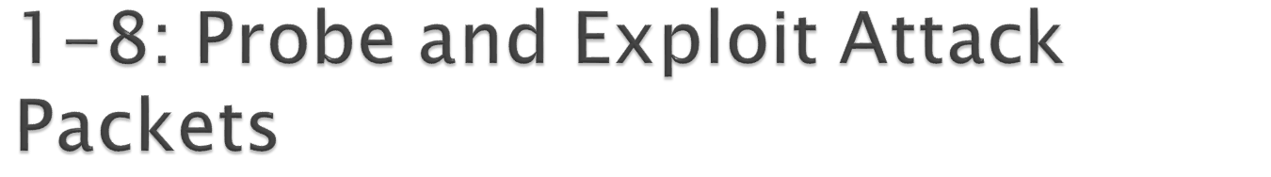
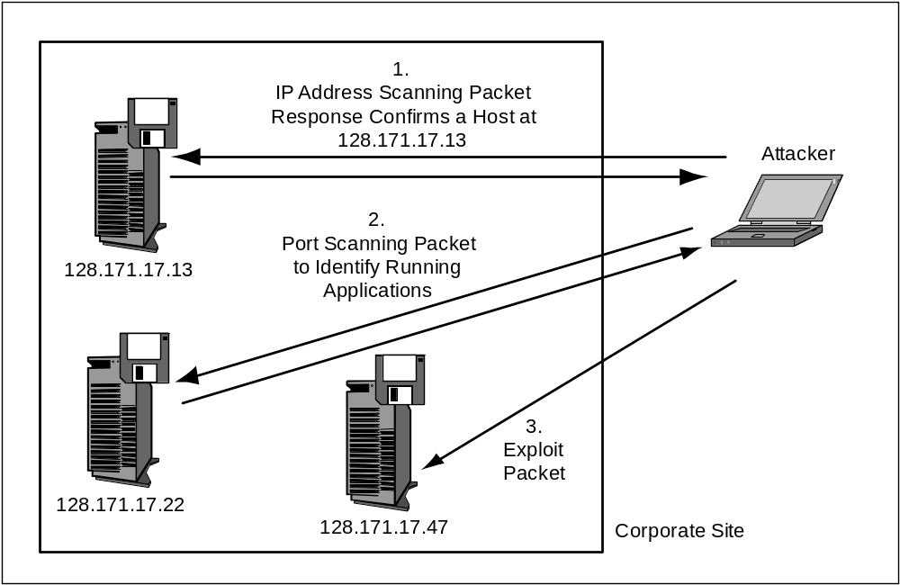
Copyright Pearson Prentice-Hall 2010

Slide 36

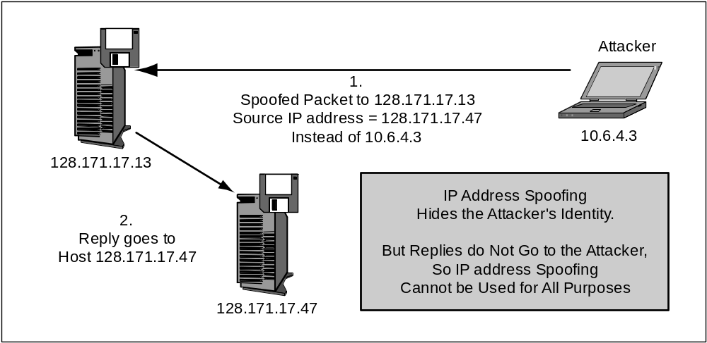
Copyright Pearson Prentice-Hall 2010

Slide 37
Chain of attack computers (Figure 1-10)
  The attacker attacks through a chain of victim computers
  Probe and exploit packets contain the source IP address of the last computer in the chain
  The final attack computer receives replies and passes them back to the attacker
  Often, the victim can trace the attack back to the final attack computer
  But the attack usually can only be traced back a few computers more
Copyright Pearson Prentice-Hall 2010

Slide 38

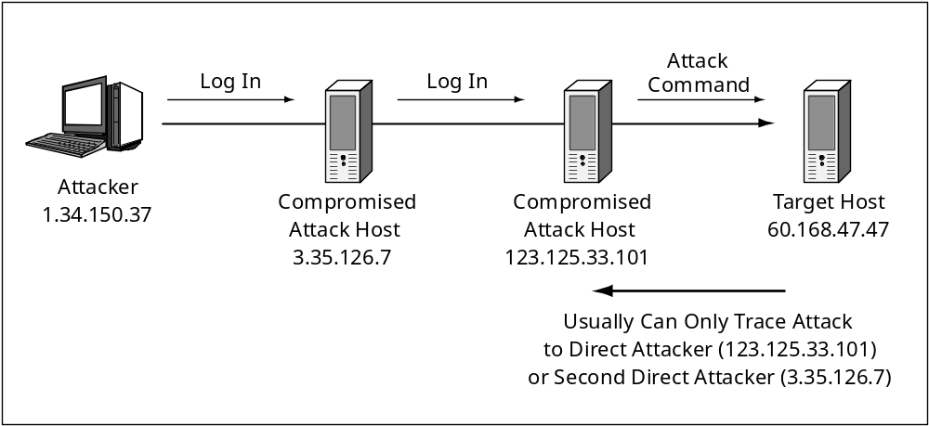
For probes whose replies must
be received, attacker sends
probes through a chain of
attack computers.
Victim only knows the identity
of the last compromised host
(123.125.33.101)
Not that of the attacker
Copyright Pearson Prentice-Hall 2010

Slide 39
Denial-of-Service (DoS) Attacks
  Make a server or entire network unavailable to legitimate users
  Typically send a flood of attack messages to the victim
  Distributed DoS (DDoS) Attacks (Figure 1-11)
    Bots flood the victim with attack packets
    Attacker controls the bot
Copyright Pearson Prentice-Hall 2010

Slide 40
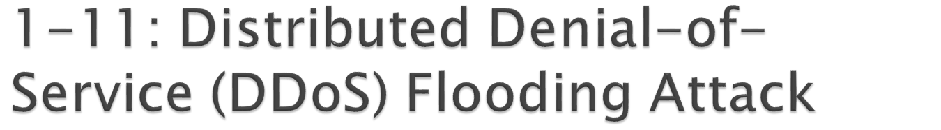
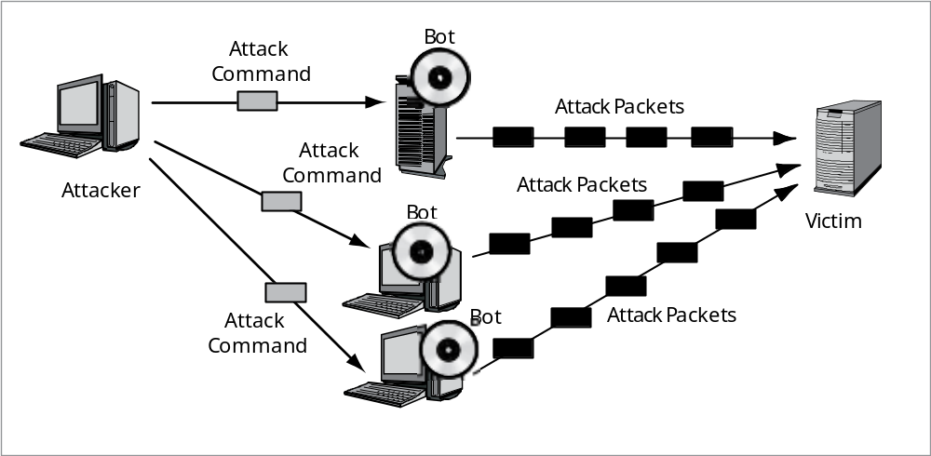
Copyright Pearson Prentice-Hall 2010

Slide 41
Bots
  Updatable attack programs (Figure 1-12)
  Botmaster can update the software to change the type of attack the bot can do
    May sell or lease the botnet to other criminals
  Botmaster can update the bot to fix bugs
Copyright Pearson Prentice-Hall 2010

Slide 42
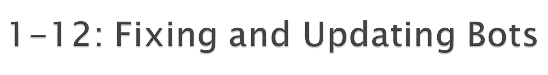
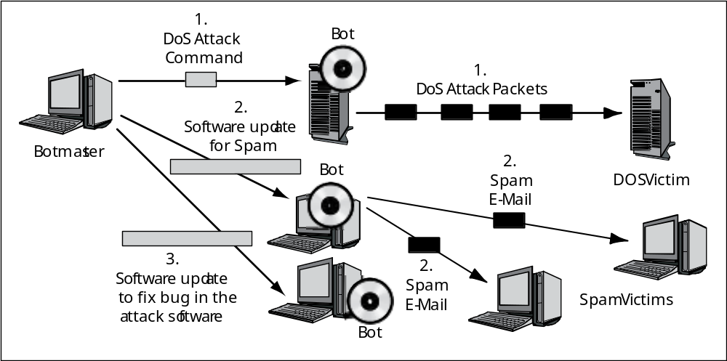
Copyright Pearson Prentice-Hall 2010

Slide 43
Skill Levels
  Expert attackers are characterized by strong technical skills and dogged persistence
  Expert attackers create hacker scripts to automate some of their work
  Scripts are also available for writing viruses and other malicious software
Copyright Pearson Prentice-Hall 2010

Slide 44
Skill Levels
  Script kiddies use these scripts to make attacks
  Script kiddies have low technical skills
  Script kiddies are dangerous because of their large numbers
Copyright Pearson Prentice-Hall 2010

Slide 45

The Criminal Era
  Today, most attackers are career criminals with traditional criminal motives
  Adapt traditional criminal attack strategies to IT attacks (fraud, etc.)
Copyright Pearson Prentice-Hall 2010

Slide 46
The Criminal Era
  Many cybercrime gangs are international
    Makes prosecution difficult
    Dupe citizens of a country into being transshippers of fraudulently purchased goods to the attacker in another country
  Cybercriminals use black market forums
    Credit card numbers and identity information
    Vulnerabilities
    Exploit software (often with update contracts)
Copyright Pearson Prentice-Hall 2010

Slide 47
Fraud
  In fraud, the attacker deceives the victim into doing something against the victim’s financial self-interest
  Criminals are learning to conduct traditional frauds and new frauds over networks
  Also, new types of fraud, such as click fraud
Copyright Pearson Prentice-Hall 2010

Slide 48
Financial and Intellectual Property Theft
  Steal money or intellectual property they can sell to other criminals or to competitors
Extortion
  Threaten a DoS attack or threaten to release stolen information unless the victim pays the attacker
Copyright Pearson Prentice-Hall 2010

Slide 49
Stealing Sensitive Data about Customers and Employees
  Carding (credit card number theft)
  Bank account theft
  Online stock account theft
  Identity theft
    Steal enough identity information to represent the victim in large transactions, such as buying a car or even a house
Copyright Pearson Prentice-Hall 2010

Slide 50
Corporate Identity Theft
  Steal the identity of an entire corporation
  Accept credit cards on behalf of the corporation
  Pretend to be the corporation in large transactions
  Can even take ownership of the corporation
Copyright Pearson Prentice-Hall 2010

Slide 51

Commercial Espionage
  Attacks on confidentiality
  Public information gathering
    Company website and public documents
    Facebook pages of employees, etc.
  Trade secret espionage
    May only be litigated if a company has provided reasonable protection for those secrets
    Reasonableness reflects the sensitivity of the secret and industry security practices
Copyright Pearson Prentice-Hall 2010

Slide 52
Commercial Espionage
  Trade secret theft approaches
    Theft through interception, hacking, and other traditional cybercrimes
    Bribe an employee
    Hire your ex-employee and soliciting or accept trade secrets
  National intelligence agencies engage in commercial espionage
Copyright Pearson Prentice-Hall 2010

Slide 53
Denial-of-Service Attacks by Competitors
  Attacks on availability
  Rare but can be devastating
Copyright Pearson Prentice-Hall 2010

Slide 54
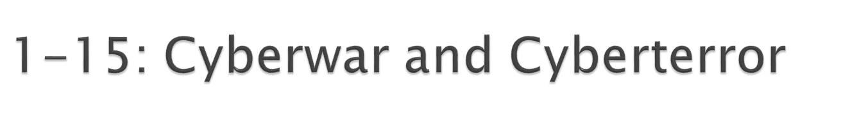
Cyberwar and Cyberterror
  Attacks by national governments (cyberwar)
  Attacks by organized terrorists (cyberterror)
  Nightmare threats
  Potential for far greater attacks than those caused by criminal attackers
Copyright Pearson Prentice-Hall 2010

Slide 55
Cyberwar
  Computer-based attacks by national governments
  Espionage
  Cyber-only attacks to damage financial and communication infrastructure
  To augment conventional physical attacks
    Attack IT infrastructure along with physical attacks (or in place of physical attacks)
    Paralyze enemy command and control
    Engage in propaganda attacks
Copyright Pearson Prentice-Hall 2010

Slide 56
Cyberterror
  Attacks by terrorists or terrorist groups
  May attack IT resources directly
  Use the Internet for recruitment and coordination
  Use the Internet to augment physical attacks
    Disrupt communication among first responders
    Use cyberattacks to increase terror in physical attacks
  Turn to computer crime to fund their attacks
Copyright Pearson Prentice-Hall 2010

Slide 57


